Slide 1



SEG3125: Lab 3
1
Online Grocery Website Alternative Design
Presented by TA Gurdarshan and TA Anisha
Faculté de génie | Faculty of Engineering
uOttawa.ca

Slide 2
Deadlines
3
The deadline for lab 3 is February 2nd at 11:59 PM
This lab is worth 3%

Slide 3
Tutorial
4
Improve your design
– https://www.w3schools.com/howto/default.asp

Slide 4
Lab 3 Introduction
5
Create an alternative design to lab 2 that’s more user- centered.
Use Design patterns to make your website appealing and easier to navigate.
Think about your choice of words.

Slide 5
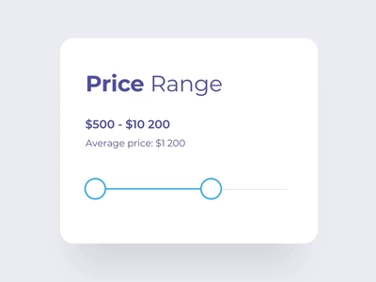
Lab 3 Introduction
6
Use UI components
Checkboxes
Dropdown lists
Toggles
Use Navigational components
Slider

Slide 6
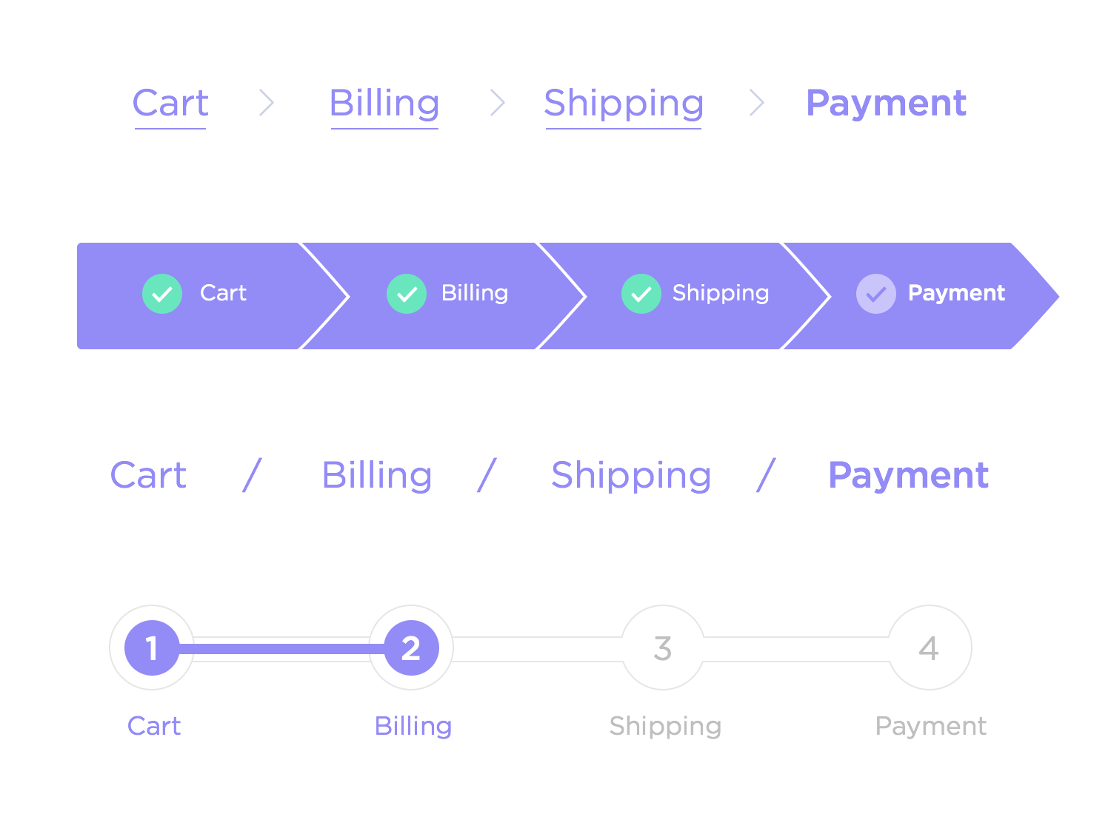
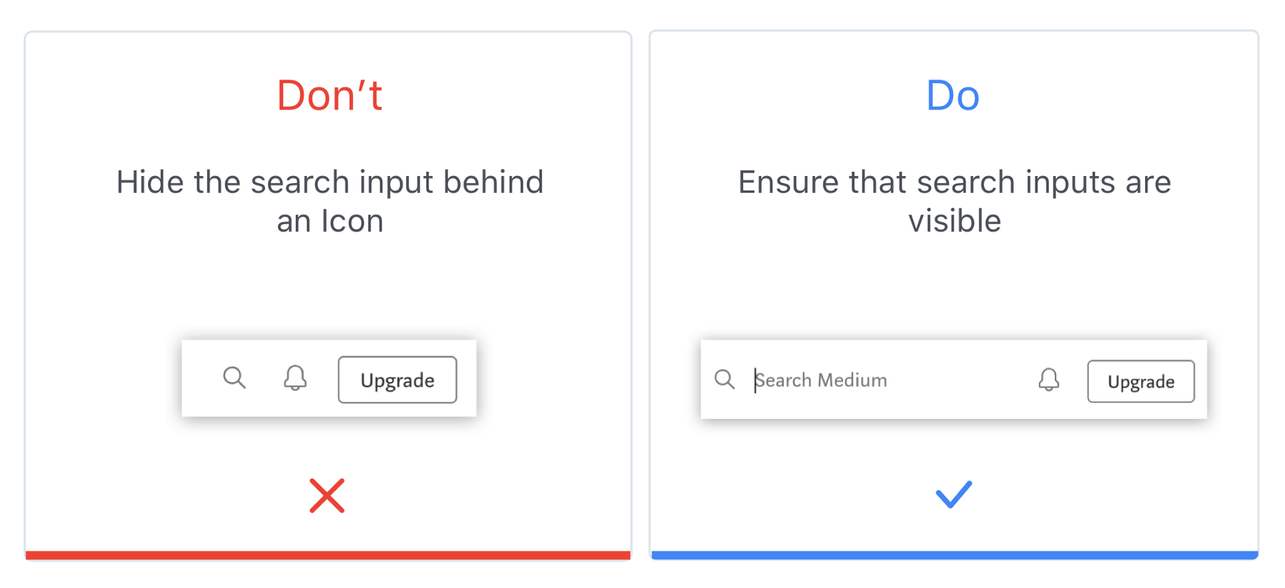
Lab 3 Introduction
6
Breadcrumbs
Search field

Slide 7
Typical Users
7
Lucie (28):
vegetarian.
Doesn’t want to be offered meats or fish.
limited budget (Products ordered from cheapest to most expensive).
Vision problems (Characters on the screen are big enough)
Eric (45):
Gluten intolerance.
Doesn’t want to be offered products with wheat in them.
Prefers organic products (Not very expensive)
Intimidated by all the vegetable names. (Prefers pictures)

Slide 8
Requirements
8
All lab 2 requirements are still required.-(Add price of products and the total in the cart page).
Add images to each product.
Choice the appropriate words for all text in website:
Buttons
Words in lists
In the instructions
Incorporate various components into your alternative design:
Lists
Radio buttons
Checkboxes

Slide 9
Requirements
9
Add categories to the products pages:
Vegetables
Fruits
Dairy
Meats
– …
Propose and implement a different navigation pattern:
Slides
Side-Menu
Breadcrumbs
– …

Slide 10
Optional Requirements
10
Not much for this lab, but if want, you can make a 3rd implementation of your design.
This will push your creativity and will make you think outside the box for new
ways to design the website.

Slide 11
Starting point
11
No starting point for this lab
Use your lab 2 work as a starting point!

Slide 12
Submissions
3
Add a pdf document in the brightspace lab section link corresponding to the lab whose submission is due.
In Brightspace, In the Lab submission link.
Submit a pdf document consisting of the following: 1)Group number 2)Group members
3)Each members contribution.
4)Snapshots of the website created
5)Link of the GitHub Repository.

Slide 13
Questions
13
Any questions???
If you have any question, you can send me an email to TAs

Slide 14
THANK YOU!
14

